Slide 1
Natural Language Processing (NLP) + LSTM Model
John Ryan
Kamalnivas Balasubramanian
Patricia Rajamanickam
Alyssa Younger

Slide 2
Topics
Background
Preprocessing and Exploratory Analysis
NLP Sentiment Scores
ML – LSTM
Challenges
Expansion Ideas
Questions

Slide 3
Background
Due to increased volatility in the current market landscape, our group utilized NLP sentiment analysis alongside an LSTM model in order to predict future stock movements to decipher whether the inclusion of NLP sentiment scores provided additional accuracy or precision.

Slide 4
Pre-processing
Tools
Techniques
NLTK
WordCloud
Lowercasing
Stopwords
Word segmentation (Tokenization)
Lemmatization
TF-IDF

Slide 5
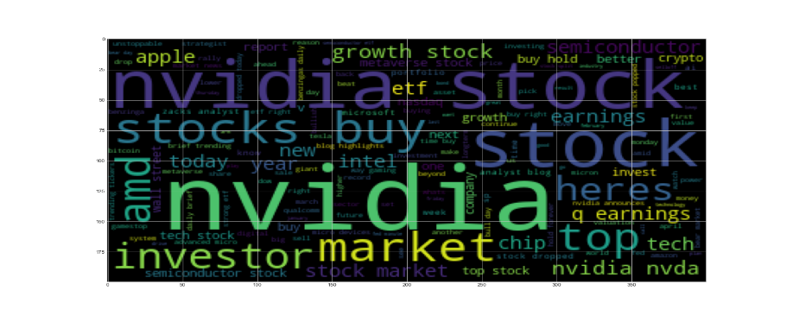
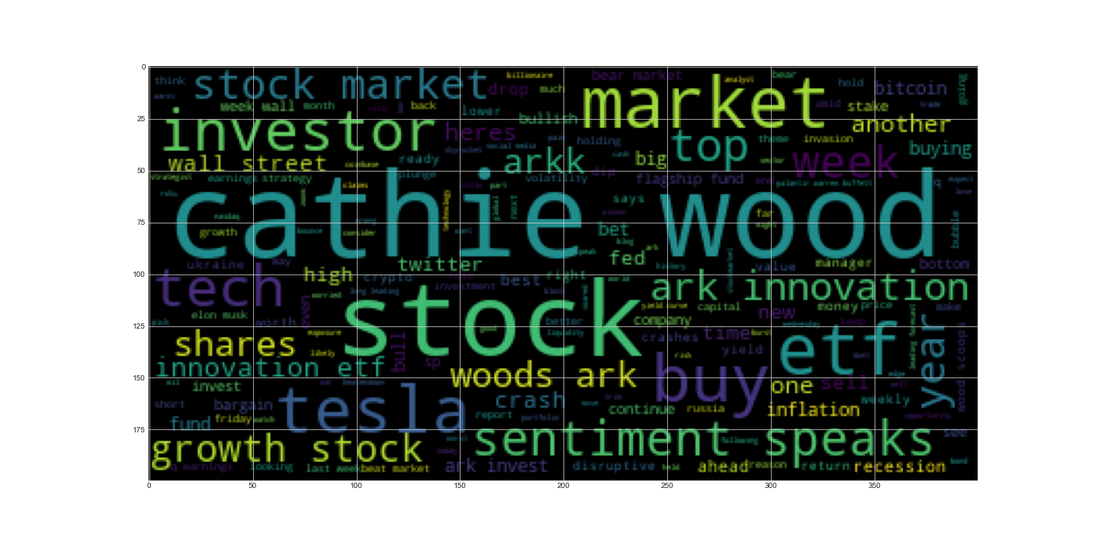
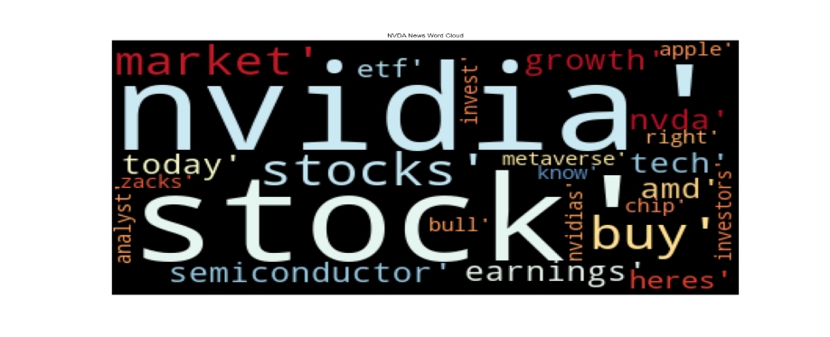
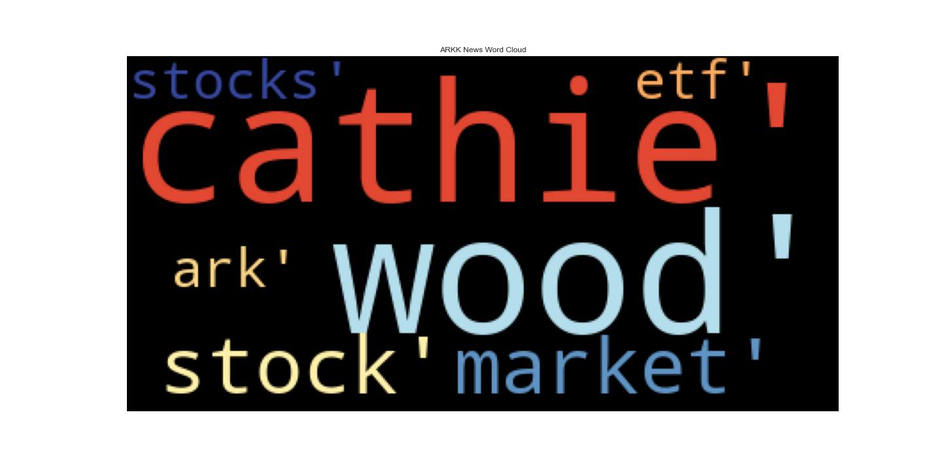
Exploratory Analysis
Wordcloud (NVDA)
Wordcloud (ARKK)

Slide 6
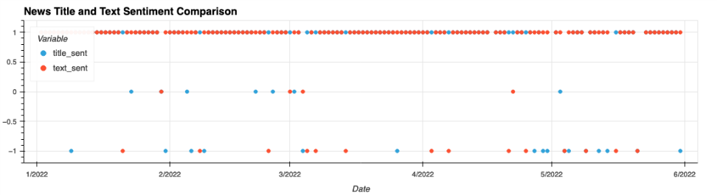
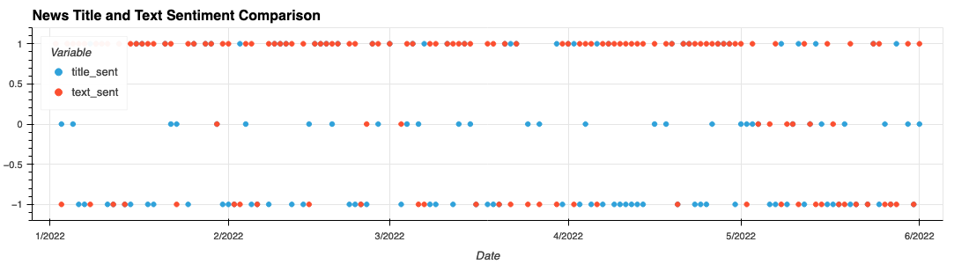
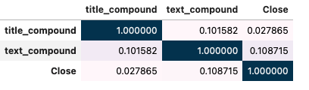
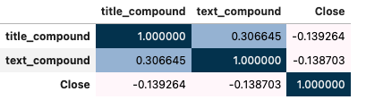
Exploratory Sentiment Analysis
Sentiment Score (NVDA)
Sentiment Score (ARKK)
Correlation (NVDA)
Correlation (ARKK)

Slide 7
NLP Sentiment Scores
Polygon Ticker News API
Sourced news articles for CY ‘22 ytd for various tickers
Performed sentiment analysis on both the title and text of new articles
Correlation metrics against stock performance to determine whether title or text compound score would serve as the main feature for the machine learning model

Slide 8
ML - LSTM
LSTM Model to predict future stock prices based upon sentiment scores
Natural Language Processing + Time Series Data
Hyperparameter Tuning
Window size
Number of Units
Dropout Ratio
Epochs
Batch Size

Slide 9
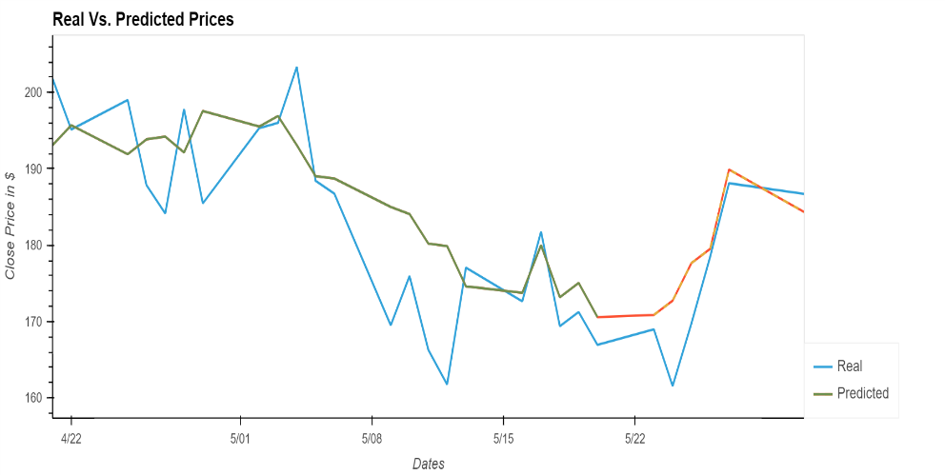
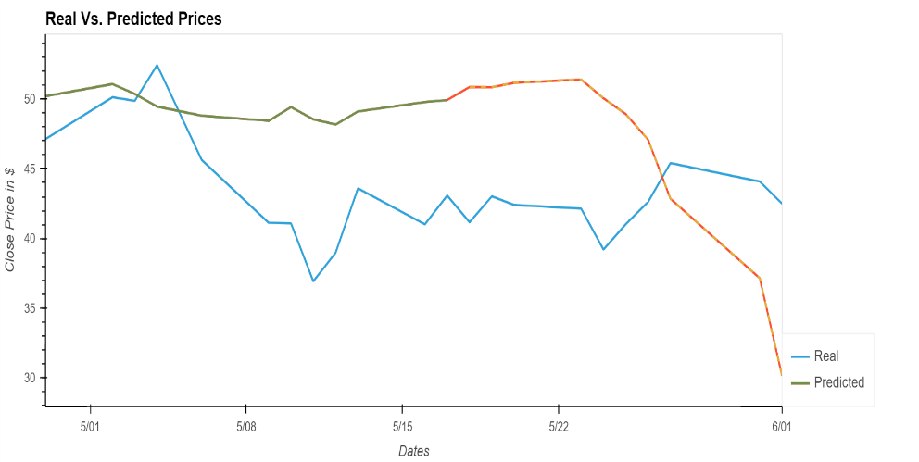
ML – LSTM Cont’d
NVDA
ARKK

Slide 10
Challenges
News data collection
Twitter / Reddit API constraints
Lack of full news article
Modifying the hyper tuning parameters

Slide 11
Expansion Ideas
LSTM model – Evaluation.
Data collection and Analysis from additional News source.
Expand News corpus volume.
Score sentiments using RNNs.
Assess and compare models’ performance.

Slide 12
Questions ?

